Slide 1
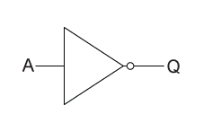
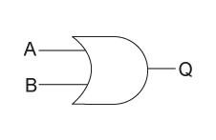
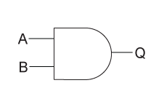

Slide 2
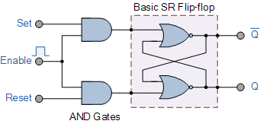
Flip flop - memory

Slide 3
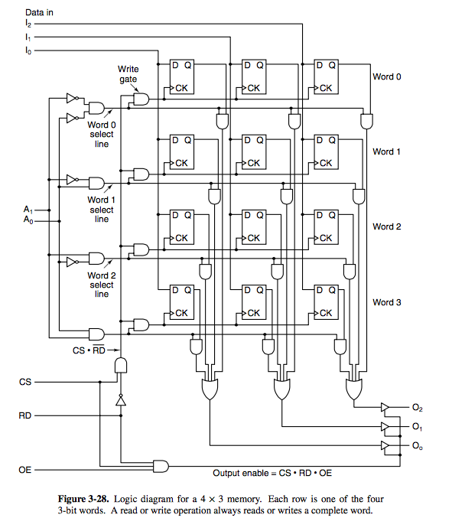
Binary
Memory
Logic to select values from memory

Slide 4
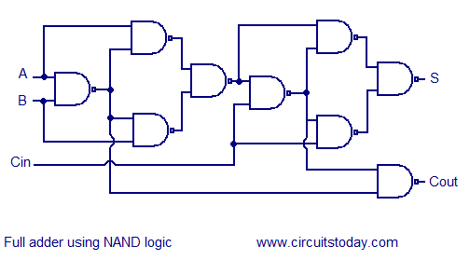
We have investigated data manipulation
Ripple adder

Slide 5
How do we make something useful?
Input
Output
Instructions
Memory

Slide 6
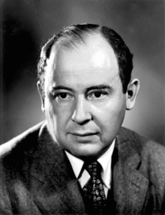
John von Neumann

Slide 7
He made major contributions to a number of fields, including mathematics (foundations of mathematics, functional analysis, ergodic theory, representation theory, operator algebras, geometry, topology, and numerical analysis), physics (quantum mechanics, hydrodynamics, and quantum statistical mechanics), economics (game theory), computing (Von Neumann architecture, linear programming, self-replicating machines, stochastic computing), and statistics.

Slide 8
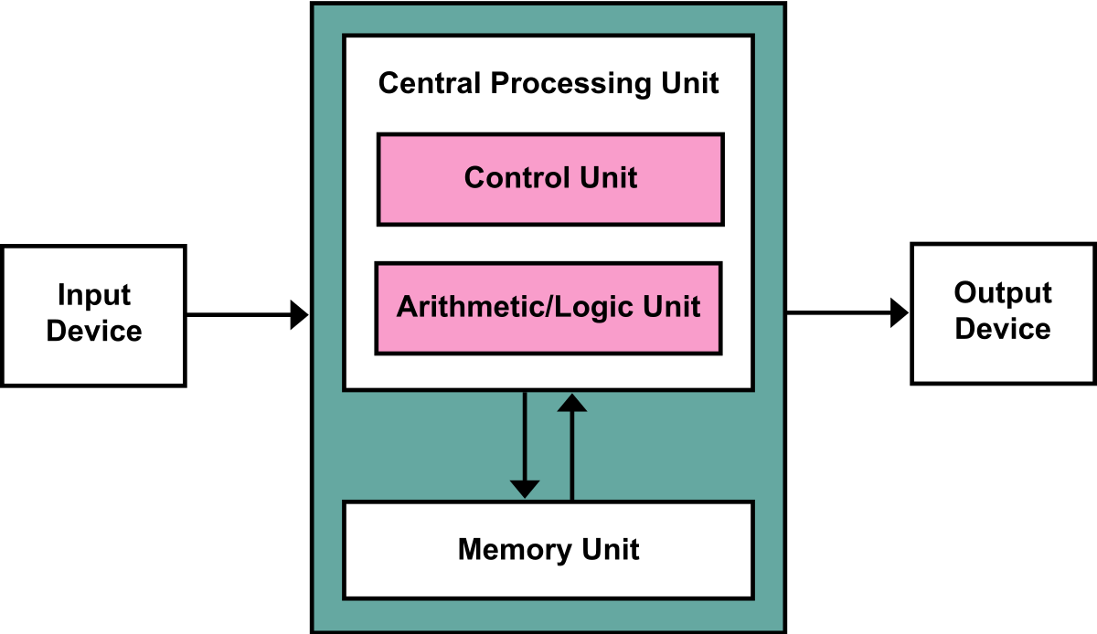

Slide 9
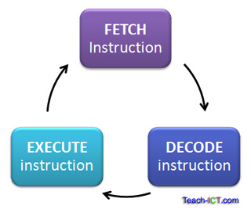
What is the purpose of the cpu?
The CPU executes programs (made up of instructions) using the fetch-decode-execute cycle

Slide 10
Fetch – decode – execute
The CPU fetches an instruction
The CPU decodes the instruction to determine what action is required
The CPU then executes that instruction
This cycle is repeated once every clock cycle, therefore the clock speed determines how fast the instructions are executed by the computer

Slide 11
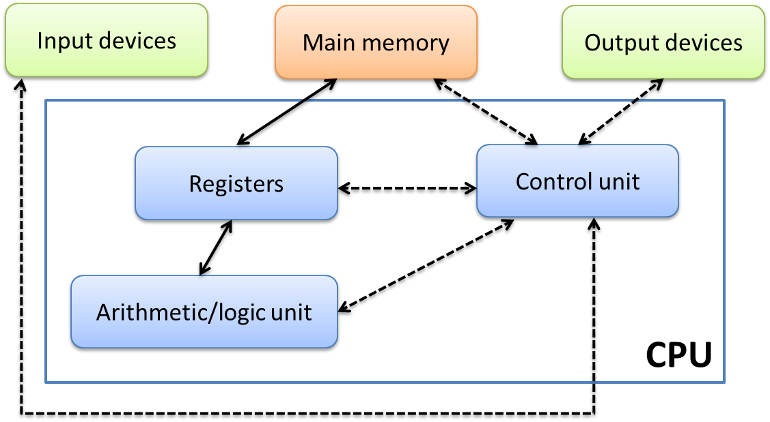

Slide 12
Arithmetic Logic Unit (ALU) - Carries out the arithmetic and
logical operations. Add, subtract, compare, multiply and divide.

Slide 13
Control unit - Responsible for interpreting instructions in a
computer program and then sending control signals to the
components.

Slide 14
Registers - Used to store single pieces of data or single
instructions immediately before or after processing.

Slide 15
Main memory (RAM)
Stores instructions and data needed by the program (volatile).
This architecture in which the data and program are stored in
the memory is known as the Von Neumann architecture.

Slide 16
https://peterhigginson.co.uk/lmc/

Slide 17
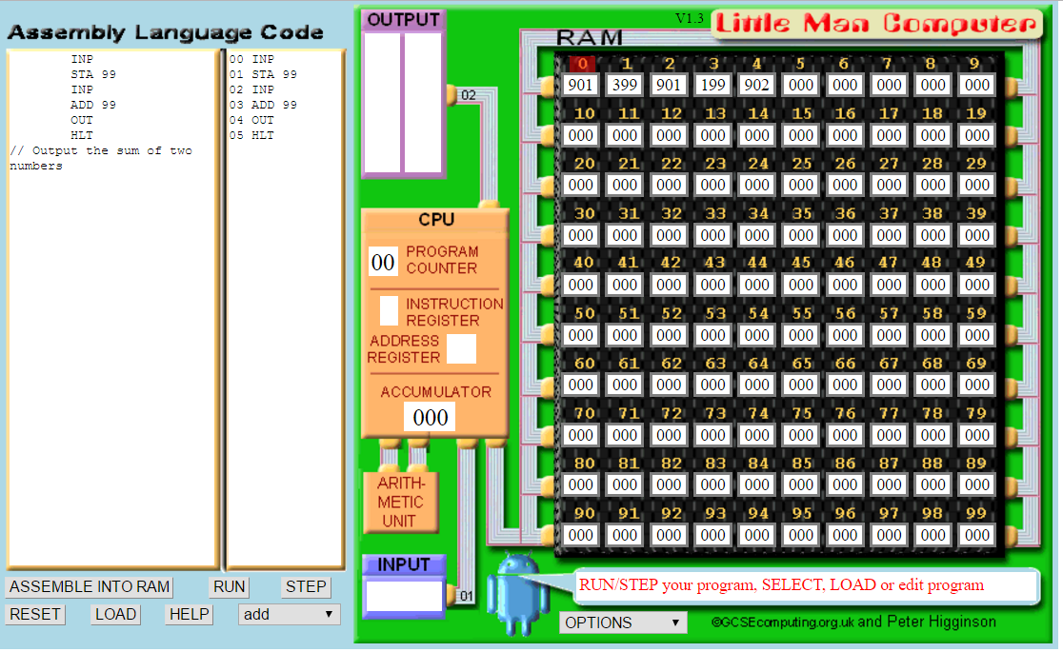

Slide 18
store into label
add two numbers
INP STA 20 OUT HLT
INP STA A OUT HLT A DAT
INP STA A INP STA B LDA A ADD B OUT HLT A DAT B DAT

Slide 19
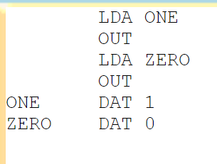
print A
subtract
lda a
OTC
a dat 65
INP STA A INP STA B LDA A SUB B OUT HLT A DAT B DAT
Store a 1
Store a 0
Output the 1
Output the 0

Slide 20
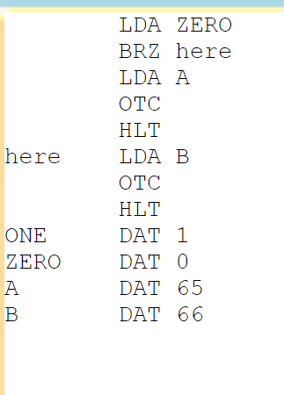
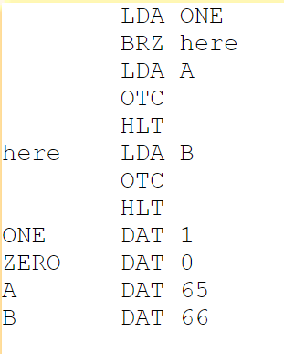
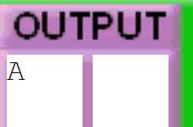
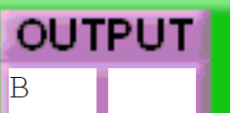

Slide 21
Little man computer
Input two numbers, add them, display result
Input two numbers, minus them, display result
Input two numbers, display the smallest
Input a number, count down to zero
Input two numbers and multiply them
Input a number, output the cube (n*n*n)
Output all odd numbers less than 100
Store and output your name (OTC)
Input your name (ASCII codes) and display it
Screen shots
Document little man computer
Document your code
Flow charts
Screen shot the code working
← pointer to a string

Slide 22
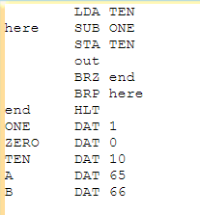
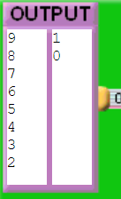
Count from 9 to 0:

Slide 23
http://www.yorku.ca/sychen/research/LMC/

